Slide 1
HACK THE pLANET!!! REGEX EDITION

Slide 2

RAGEX
Rageluar Expressions

Slide 3

What are they?
A regular expression (shortened as regex or regexp) is a sequence of characters that specifies a search
pattern

Slide 4
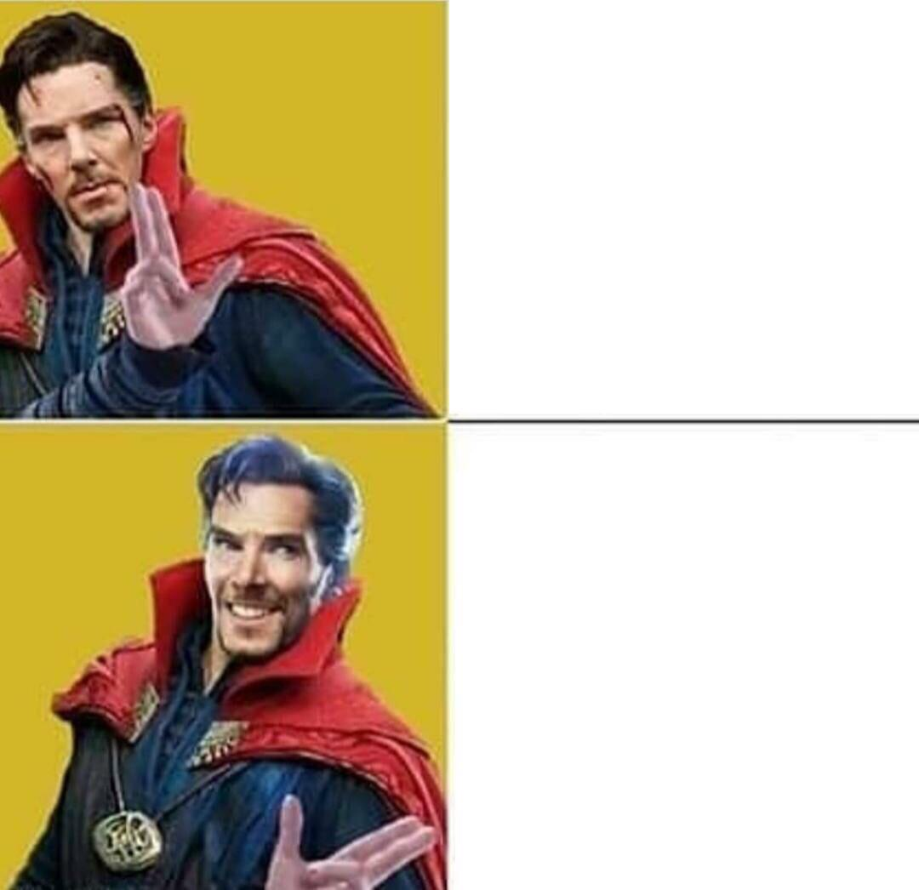
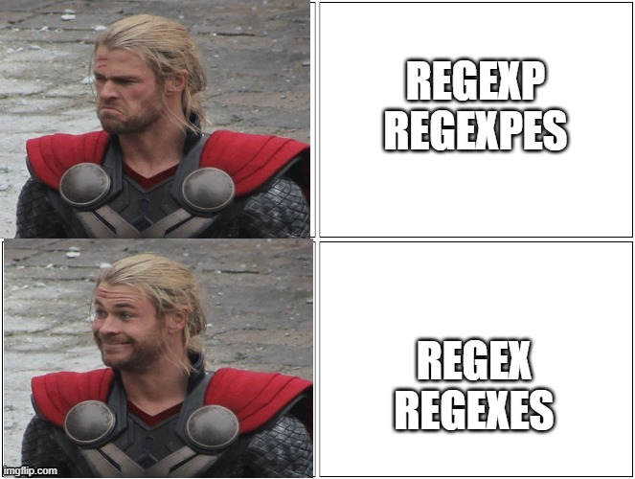

Slide 5
Standard?
Basic (Simple)
Escape meta char \( \), etc
Extended
Adds ?, + and |
No escape meta chars
PCRE
LOTS of syntax
Closest thing to a standard
PCRE != Perl regex

Slide 6

Standard?
Basic (Simple)
Extended
PCRE

Slide 7
GNU grep has the following options: "grep -E" for ERE, and "grep -G" for BRE (the default), and "grep -P" for Perl regexes

Slide 8
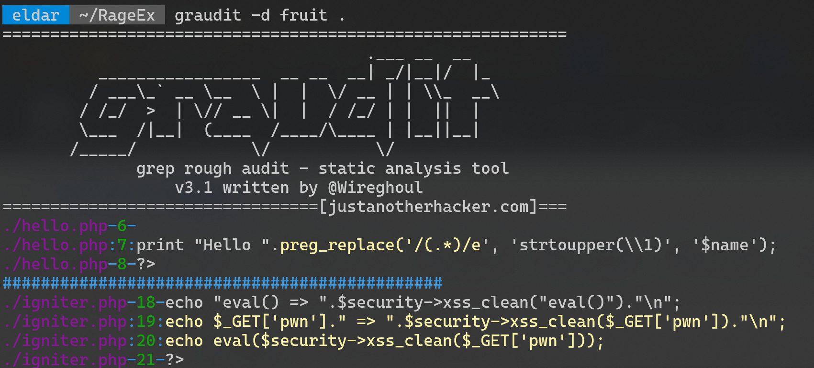

Slide 9


Slide 10
METACHARATERS
^ $ | Start and end of string (or line)
. | Match any single character
[ ] | Matches any character inside the bracket
[^ ] | Matches any character NOT inside the bracket
( ) | Scope boundary or group
\1 \2 \n | Back references to groups
| | Matches the expression before or after the operator
* | Matches none or more characters
+ | Matches one or more characters
? | Matches none or one character
{ } | Matches a range of characters

Slide 11
Character classes
Lets match alpha-numeric strings:
[ABCDEFGHIJKLMNOPQRSTUVWXYZabcdefghijklmnopqrstuvwxyz1234567890]+
[A-Za-z0-9]+
\w+

Slide 12

Character classes
Shortens/simplifies pattern
Causes “line-noise”
Every language is an island!

Slide 13
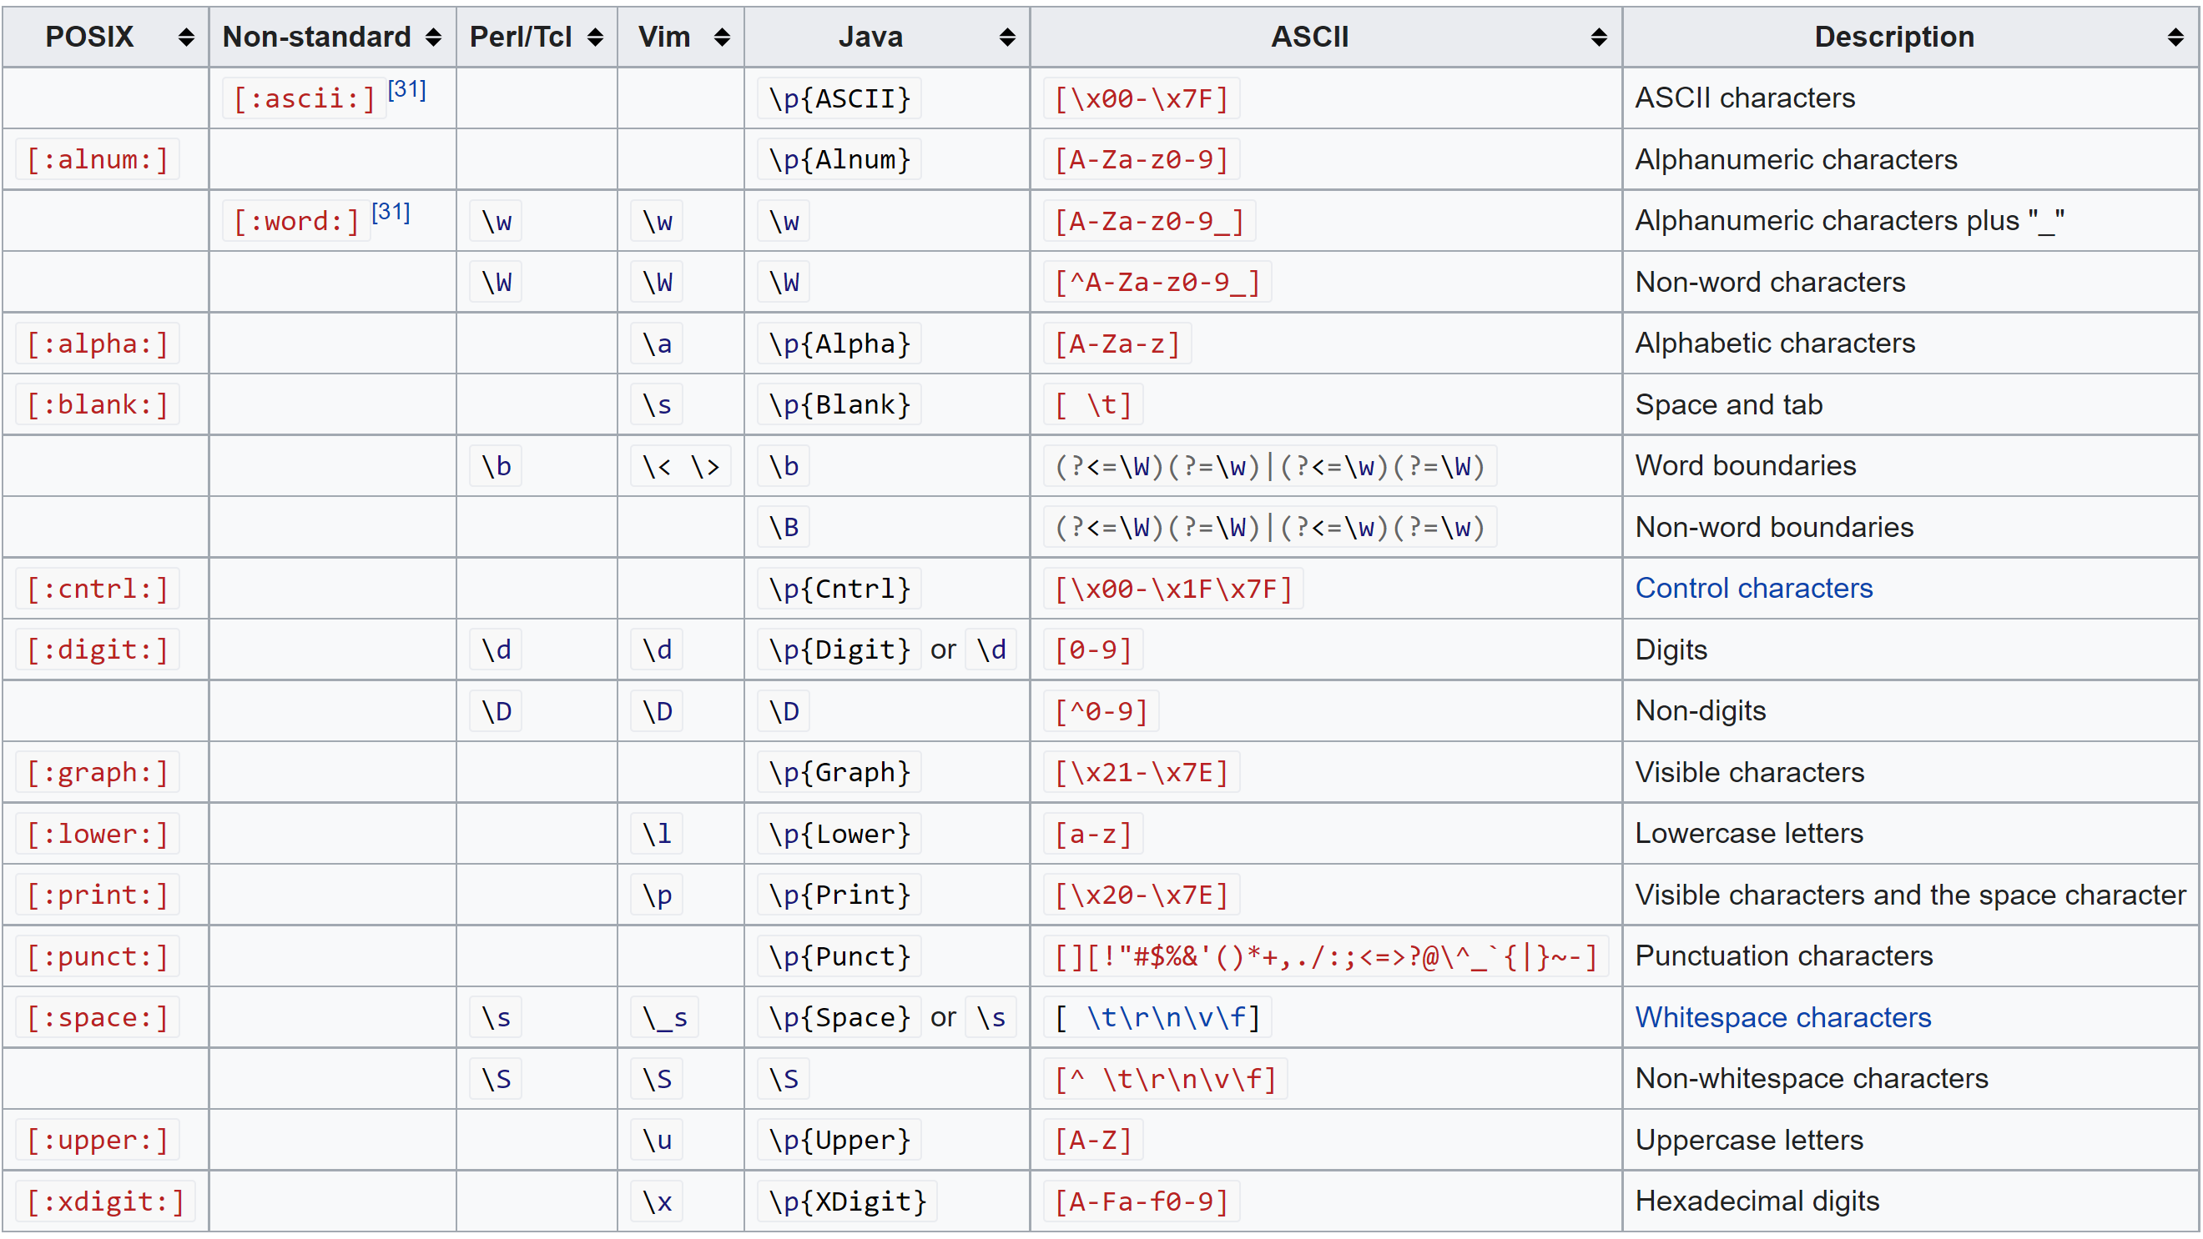

Slide 14


Slide 15
What Are we matching?
[A-Z][a-z]+
[[:alnum:]]*
\b\w+\b
[hH][tT]{2}[pP][sS]?://([^\.]+)\.(.+)

Slide 16
What are we matching?
(?:[a-z0-9!#$%&'*+/=?^_`{|}~-]+(?:\.[a-z0-9!#$%&'*+/=?^_`{|}~-]+)*|"(?:[\x01-\x08\x0b\x0c\x0e-\x1f\x21\x23-\x5b\x5d-\x7f]|\\[\x01-\x09\x0b\x0c\x0e-\x7f])*")@(?:(?:[a-z0-9](?:[a-z0-9-]*[a-z0-9])?\.)+[a-z0-9](?:[a-z0-9-]*[a-z0-9])?|\[(?:(?:25[0-5]|2[0-4][0-9]|[01]?[0-9][0-9]?)\.){3}(?:25[0-5]|2[0-4][0-9]|[01]?[0-9][0-9]?|[a-z0-9-]*[a-z0-9]:(?:[\x01-\x08\x0b\x0c\x0e-\x1f\x21-\x5a\x53-\x7f]|\\[\x01-\x09\x0b\x0c\x0e-\x7f])+)\])

Slide 17

What are we matching?
(?:[a-z0-9!#$%&'*+/=?^_`{|}~-]+(?:\.[a-z0-9!#$%&'*+/=?^_`{|}~-]+)*|"(?:[\x01-\x08\x0b\x0c\x0e-\x1f\x21\x23-\x5b\x5d-\x7f]|\\[\x01-\x09\x0b\x0c\x0e-\x7f])*")@(?:(?:[a-z0-9](?:[a-z0-9-]*[a-z0-9])?\.)+[a-z0-9](?:[a-z0-9-]*[a-z0-9])?|\[(?:(?:25[0-5]|2[0-4][0-9]|[01]?[0-9][0-9]?)\.){3}(?:25[0-5]|2[0-4][0-9]|[01]?[0-9][0-9]?|[a-z0-9-]*[a-z0-9]:(?:[\x01-\x08\x0b\x0c\x0e-\x1f\x21-\x5a\x53-\x7f]|\\[\x01-\x09\x0b\x0c\x0e-\x7f])+)\])

Slide 18
https://regexr.com/

Slide 19
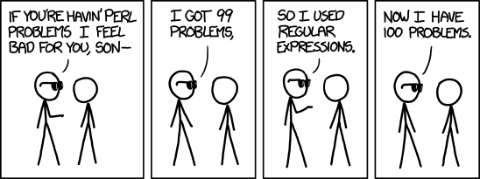

Slide 20

Greedy Matching
In most implementations the *, + and ? quantifiers are greedy. Meaning they will match as many chars as possible
“.*”
"Gareth," he said, "is called the great one“
"Gareth," he said, "is called the great one"

Slide 21
ReGEX Denial of service
The Regular expression Denial of Service (ReDoS) exploits algorithm to reach extreme situations that cause them to work very slowly
^(a+)+$
For the input aaaaX there are 16 possible paths in the above graph. But for aaaaaaaaaaaaaaaaX there are 65536 possible paths, and the number is double for each additional a.
Groups in groups and quantified quantifiers
Not always a clear quantifier inside and outside the group:
(a|aa)+
(a|a?)+
(([a-z])+.)+

Slide 22
Modifiers
/pattern/m
i – Case insensitive
m – Multiline
s – Single string
g – Global matching
e – Eval
Many more
In-pattern modifiers
(:?[a-z]) – No-capture
*?, +? – Non greedy
[^a-z] – Non-match
(?i)a – Variant of /a/i

Slide 23
Modifiers
Can be mixed?!?!?
/n can be negated on a per-group basis.
"hello" =~ /(?-n:(hi|hello))/n;
# $1 is "hello"

Slide 24

Modifiers
Can be mixed?!?!?
/n can be negated on a per-group basis.
"hello" =~ /(?-n:(hi|hello))/n;
# $1 is "hello"

Slide 25
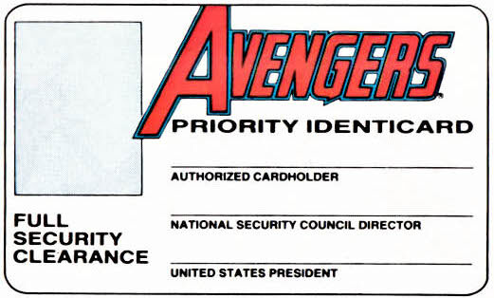
INPUT VALIDATION

Slide 26

REMOVE NON ALPHA CHARS
<?php $safe = preg_replace('/[^A-z]/','', $_GET['hostname']); passthru("ping -c 3 $safe 2>&1");
?>

Slide 27
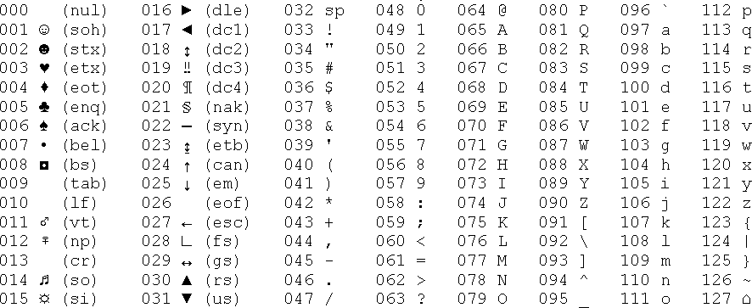
ASCII

Slide 28
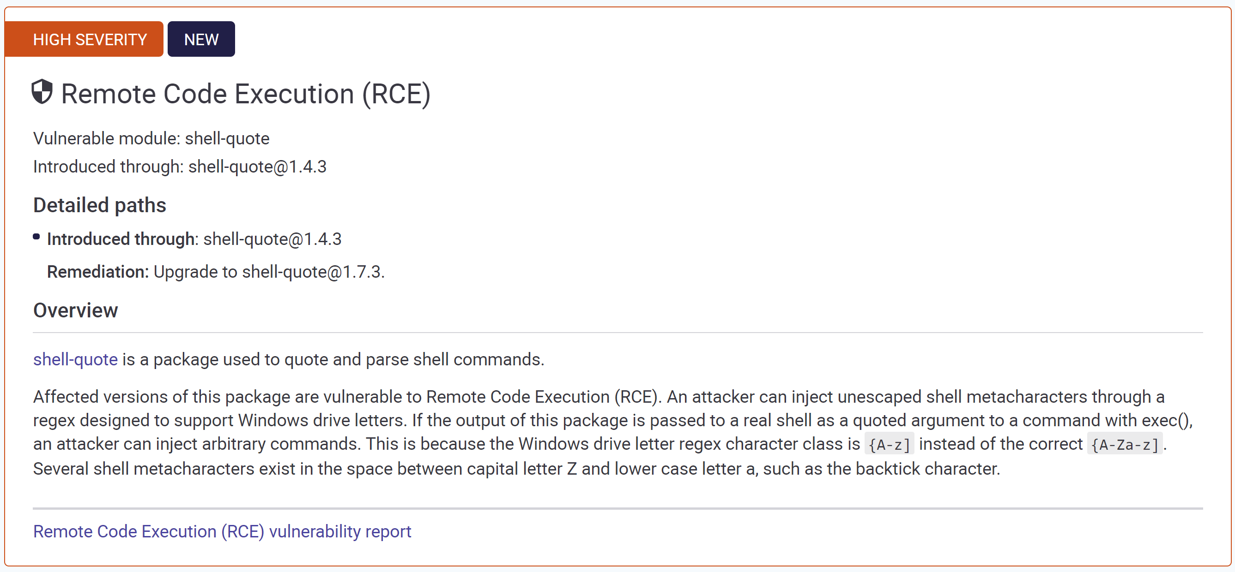

Slide 29

Obligatory “0-day”

Slide 30
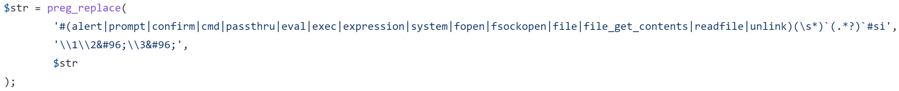
Code igniter filter bypass
Bad regex
Bypassable
https://github.com/bcit-ci/CodeIgniter/blob/develop/system/core/Security.php#L532

Slide 31
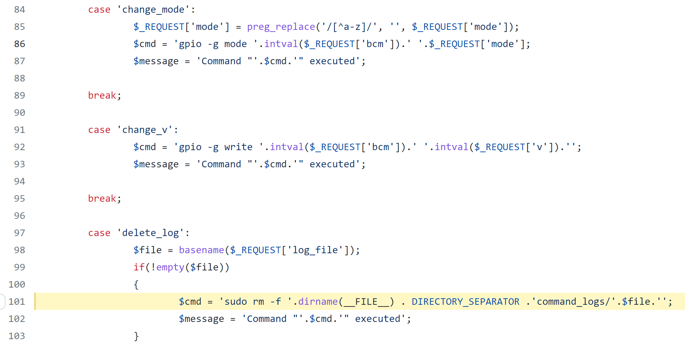
ANTS STATION REMOTE ROOT
https://github.com/moonkracker/Ants-Station/blob/main/Dashboard/ajax.php#L101
Notes:
This is actually a common pattern for Raspberry PI web panels, unsure which code base used it first

Slide 32
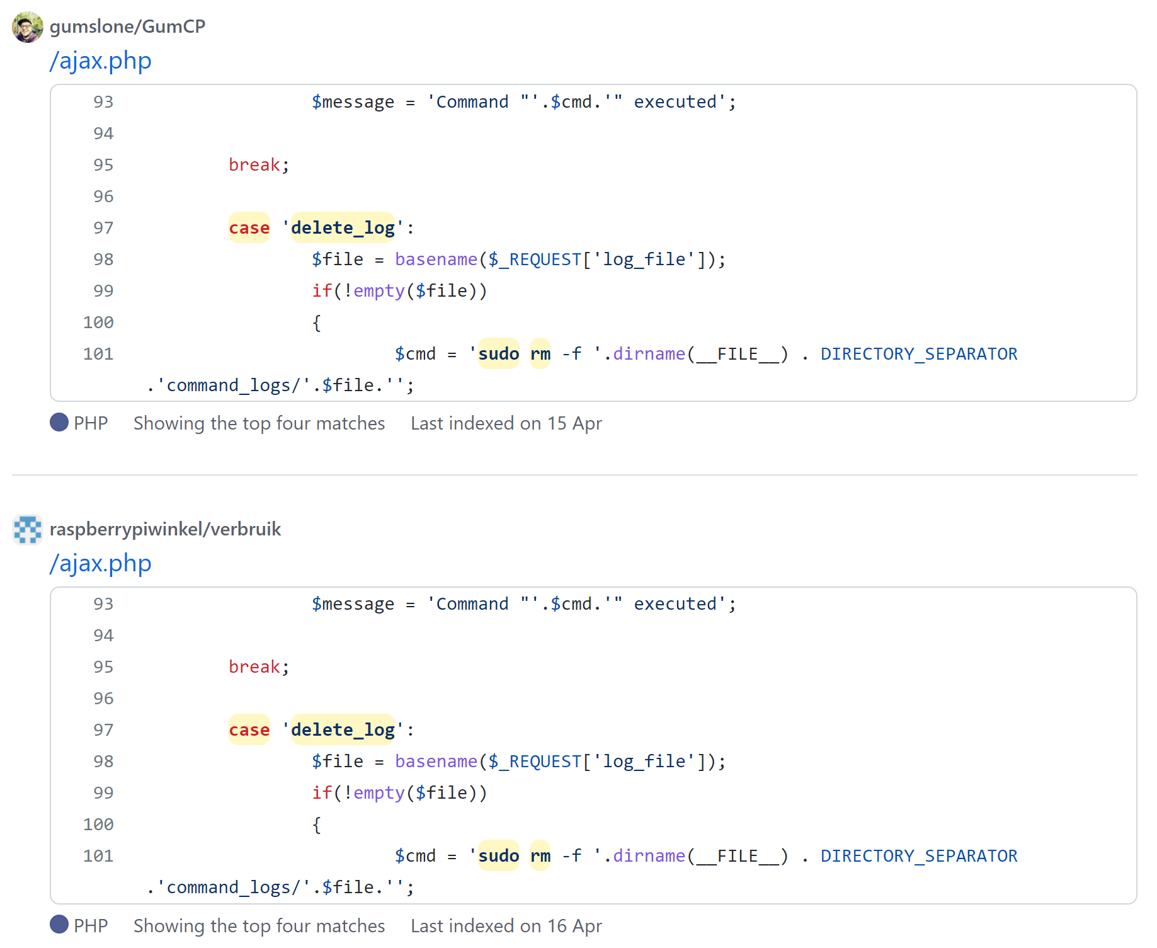

Slide 33

In SUMMARY
Fiddly
Clunky
Not portable
Rage inducing
Great for once off problems
Can add BAD vulns
Easy bypasses in defence solutions

Slide 34

THANKS!
Any questions?
https://github.com/EMSeek/RageEx

